Slide 1
Analysis and Differentiation of the Use of Cyclist Rental Bikes by Casual Riders and Annual Members.
January 2023
Aqdas Ansari

Slide 2


Today's agenda
Project recap
Problem
The Analytics team
Process
Insights
Summary

Slide 3


Cyclist is a fastest growing bike rental company. Majority of bike borrowers are casual rider. Cyclist has a great potential to grow it’s revenue by converting it’s casual riders into annual members.
Project Recap
Differentiation and analysis of casual cyclist and annual members way of use.
Recommendations for a successful marketing strategy

Slide 4



Marcus Rompton
Senior Principle
The Analytics team
Andrew Flaming
Chief Technical Architect
Aqdas Ansari
Data Analyst

Slide 5


Process
1
Data Understanding
2
Data Cleaning
3
Data Modelling
4
Data Analysis
5
Uncover Insights

Slide 6


Insights
STREETER GRAND AVE STATION
FRIDAY
JULY
WEEK DAY WITH
MOST RIDES
MOST USED
STATION
MONTH WITH
MOST RIDES

Slide 7
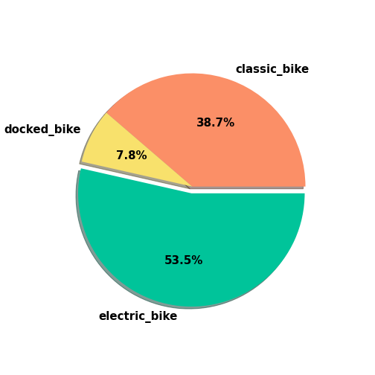
Key takeaways:
By looking at 11+ months of past data, we’re able to identify electric bikes are the most frequently booked type of bike.
Most Preferable bike used for covering large distance is Classic bikes.
Docked bike is used very little or not at all.

Slide 8
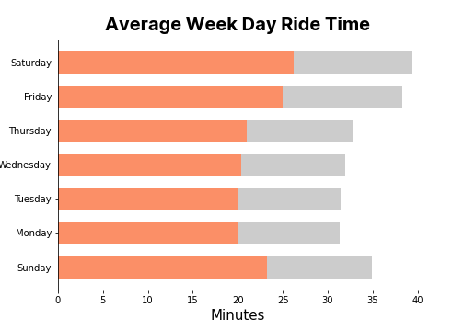

Slide 9
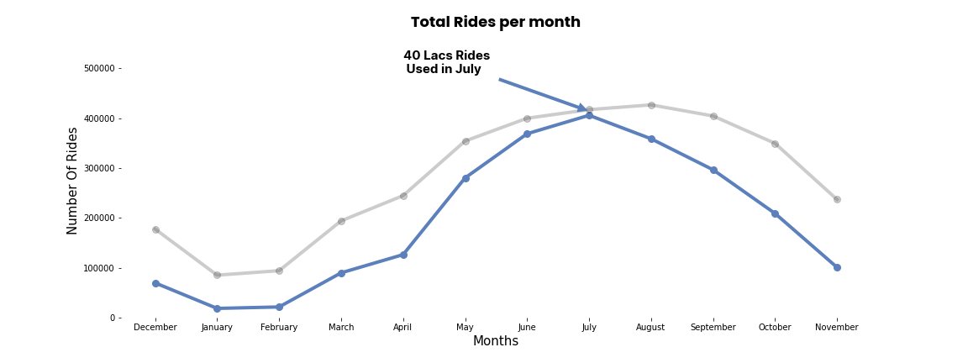

Slide 10
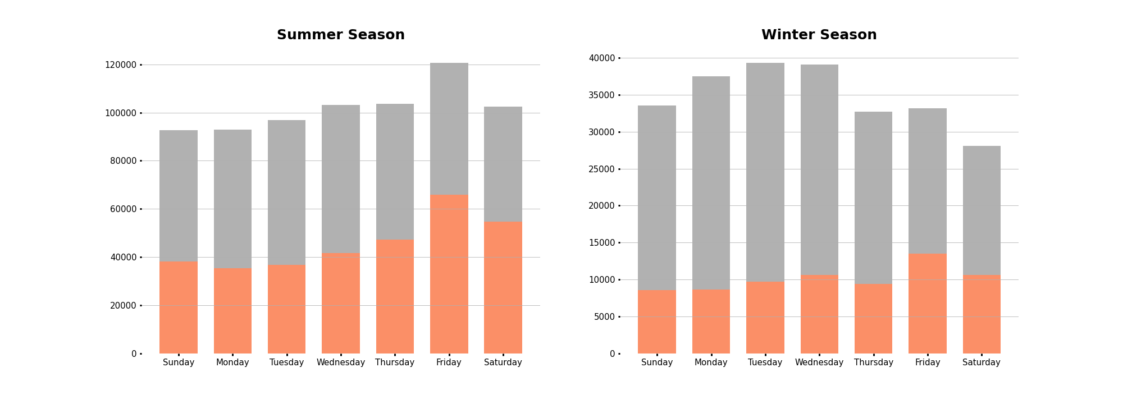

Slide 11


ANALYSIS
Our data reveals that June and July are the months with the highest number of ride bookings, and Friday, Saturday, and Sunday are the most popular days for booking rides.
INSIGHT
The most common station among casual riders is Streeter Grand Ave station. The Casual riders mostly used classic bike for large distance, for shorter distance they prefer to use electric bike.
Summary
NEXT STEP
Create marketing strategies based on these finding to convince the casual riders buy annual membership.

Slide 12

Thank you!
ANY QUESTIONS?

